Slide 1
Meet Knock
Team SICKOCODE

Slide 2

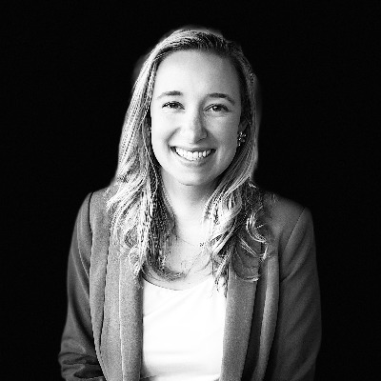
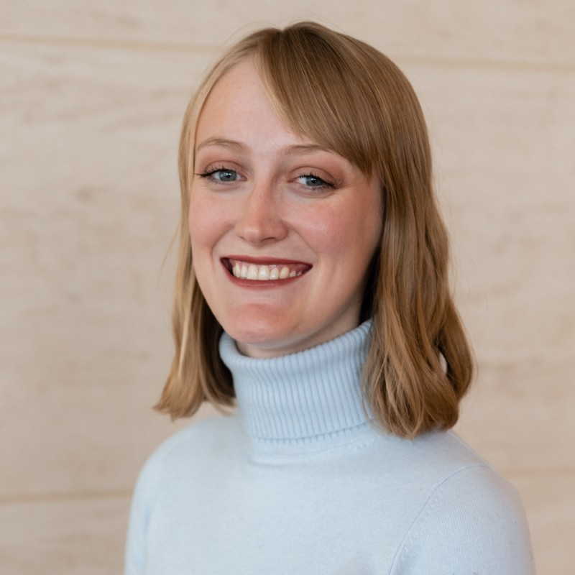
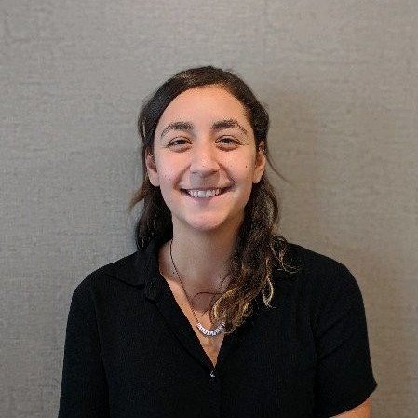
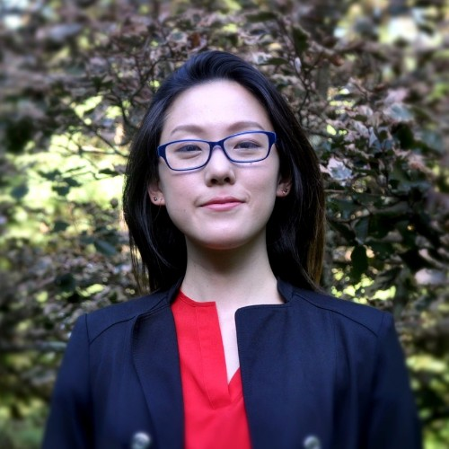
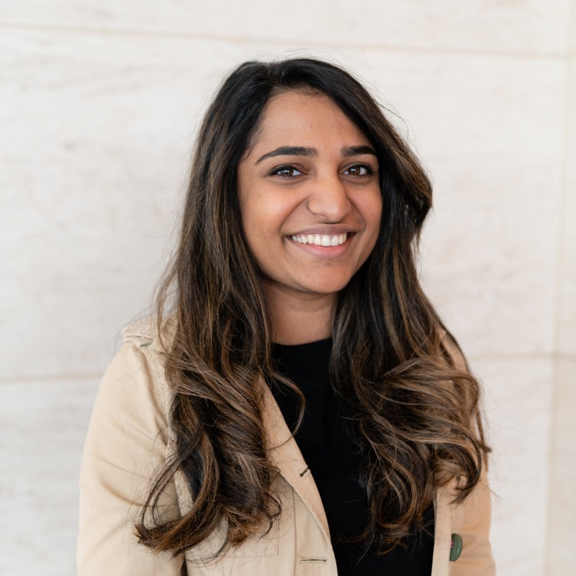
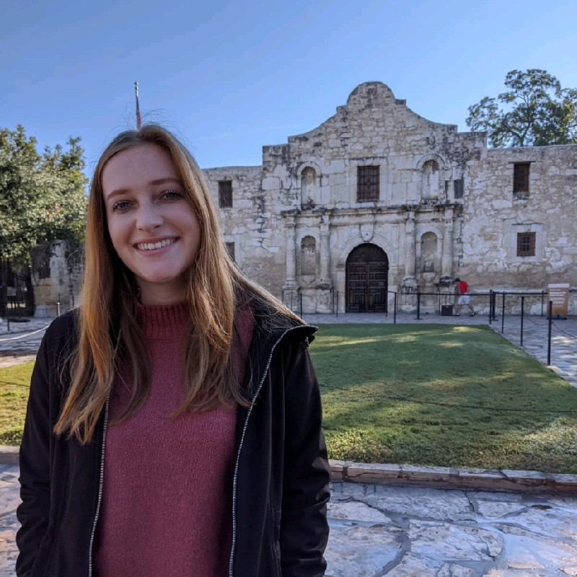
Team SICKOCODE
Sarah Davidson
Fiona Harkin-Newsome
Talullah Kay
Serena Kuang
Seema Patel
Sarah Tucker

Slide 3
How might we develop a technology solution that promotes and/or enhances the fight against breast cancer?

Slide 4
Think globally
Target all people
Reach people on familiar platforms
Gentle & relevant communications

Slide 5

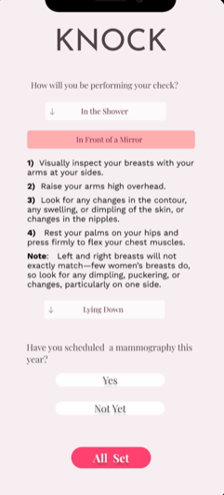
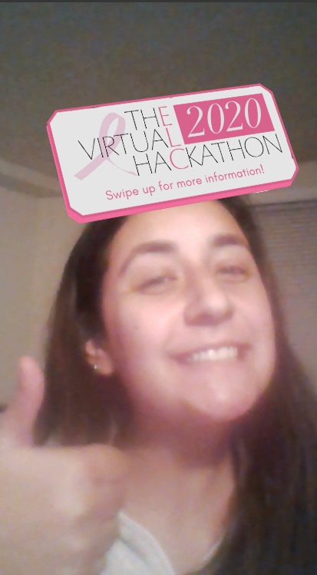
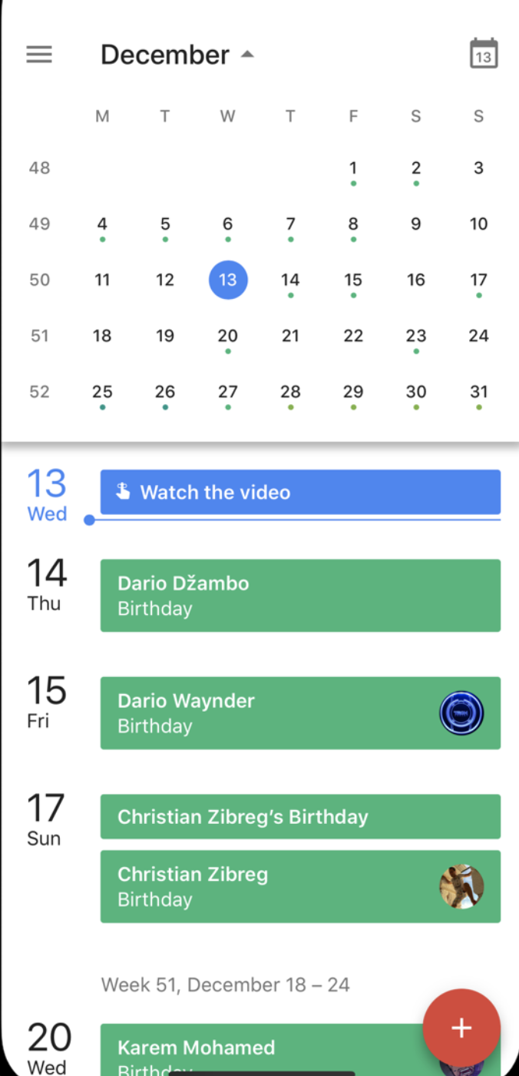


Slide 6

Not a breast cancer patient
Jonathan
Age 25
PROFILE
Jonathan is not a breast cancer patient, but he has family members and work colleagues that have been affected by the disease. He wants to better understand how he can support them in their cancer journey and help educate people about the disease in general. He’s tried getting involved before, but was ultimately deterred by the overwhelming number of resources.
Familiarity with Breast Cancer
Low
High
Willingness to Get Involved
Low
High
Technology User
Novice
Expert
Pain Points
PREFERENCES
Breast cancer is not top of mind for him
Unsure of the best way to support friends and families on their personal breast cancer journeys
Most information he’s found is around the actual disease rather than advice for support and/or volunteer opportunities
Likes being well-informed before sharing information
Doesn’t want to download a new app or create an account to get the information he wants
Simple is better

Slide 7

At higher risk for breast cancer
Katherine
Age 46
PROFILE
Katherine is not a breast cancer patient. However, she does have a family history of breast cancer. She is currently aware that she is at higher risk for breast cancer, but has not gotten a mammogram. She is a frequent user of technology and social media, specifically Instagram.
Familiarity with Breast Cancer
Low
High
Technology User
Novice
Expert
Anxiety Level
Low
High
Pain Points
PREFERENCES
Unfamiliar with the journey and treatment process of breast cancer patients
Overwhelmed by information available; fatigue of sifting through materials that are not relevant to her
Likes her life to be organized
Wants to leverage digital tools she’s already using to help manage her breast cancer prevention

Slide 8
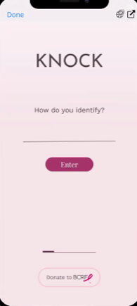

Slide 9
PinkData Award by HCL

Slide 10
Thank you!

